Slide 1
Introduction to Quantum Computing: From a Layperson to a Programmer in 30 Steps
Hiu-Yung Wong
https://link.springer.com/book/10.1007/978-3-030-98339-0
https://www.amazon.com/Introduction-Quantum-Computing-Layperson-Programmer/dp/3030983382
Playlist: https://www.youtube.com/watch?v=J1yvLOs39iA&list=PLnK6MrIqGXsJfcBdppW3CKJ858zR8P4eP&index=18
https://www.youtube.com/watch?v=vDD4N0MqBUg&list=PLnK6MrIqGXsJfcBdppW3CKJ858zR8P4eP&index=19
https://www.youtube.com/watch?v=1hi77Sq-2O0&list=PLnK6MrIqGXsJfcBdppW3CKJ858zR8P4eP&index=20

Slide 2


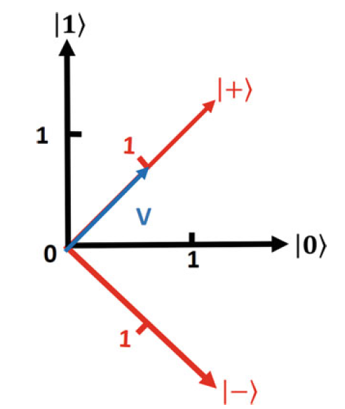




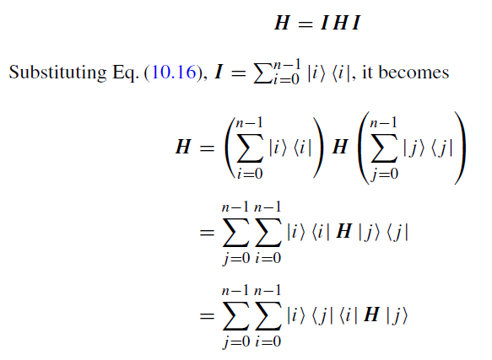
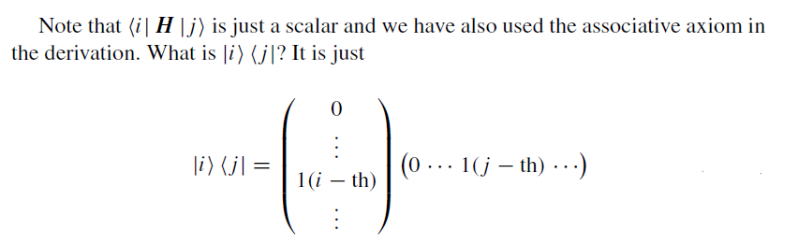
Matrix Representation in a given Basis

Slide 3

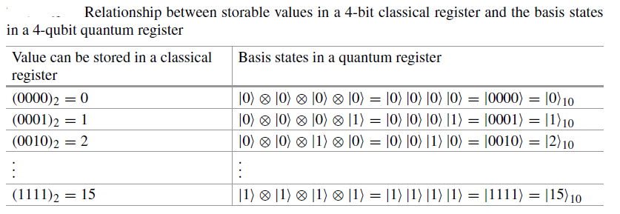

Quantum Register
Collection of Qubits
4 Qubits

Slide 4


n-bit Register General Value
A 2-qubit register stores a state in the C4 Hilbert space which is a tensor product space of two 1-qubit systems (C2⊗C2). A vector example in this space is,

Slide 5
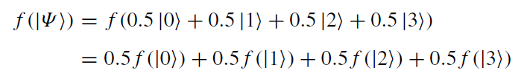
Quantum Data Processing
Apply Unitary transformation to a state vector, in which different values of the register are present simultaneously.
4-qubit quantum register

Slide 6


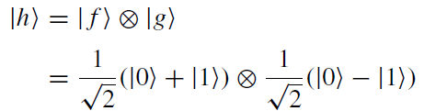
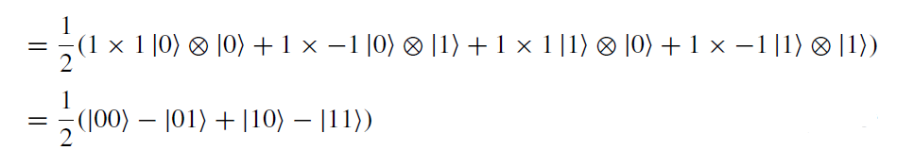

Entanglement
$$H_{3}=H_{1}⊗H_{2}$$
$$h=\sum_{j=1}^{n}{f_{j}⊗g_{j}}$$
Given state can decompose into tensor product of two space vectors
Can → Not Entangled
Cannot → Not Entangled
Ex :-

Slide 7

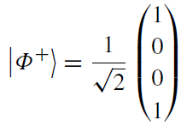
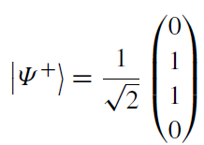
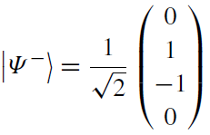
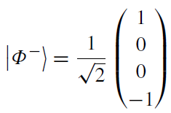


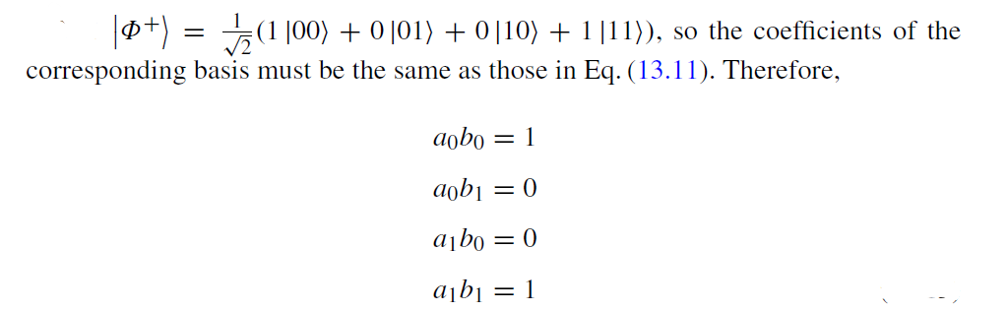
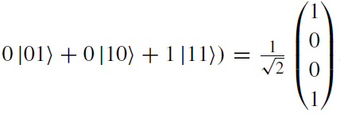

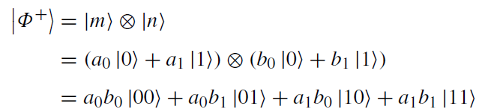
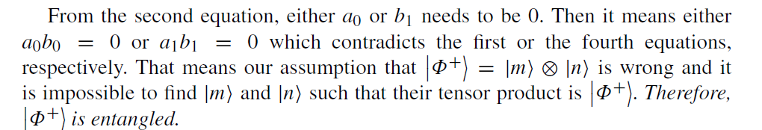
Bell Basis States And Entanglement
Regular basis
(All are entangled)
Proof by Contradiction

